Slide 1
Logistic Regression
File: cs2m.csv

Slide 2
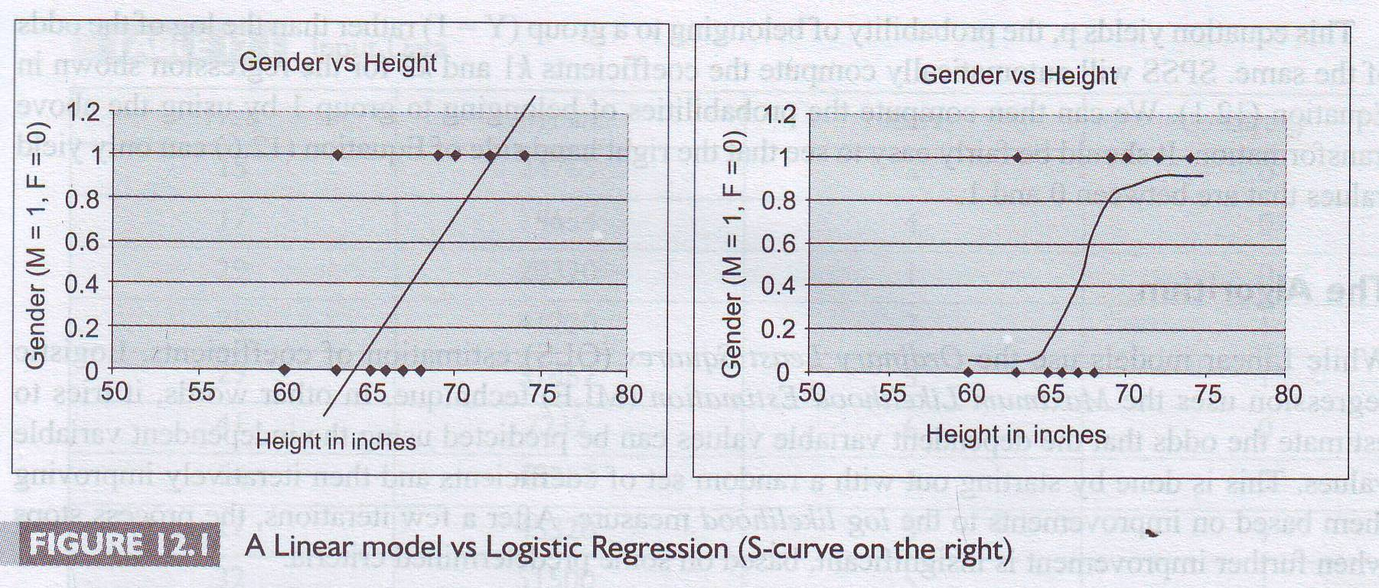
Logistic Regression
Classification Scheme
Source: Nargundkar, R. (2010), Chapter 12: Logistic Regression For Classification and Prediction,
In Marketing Research, 3rd edition, TMH, New Delhi, (p. 308)

Slide 3
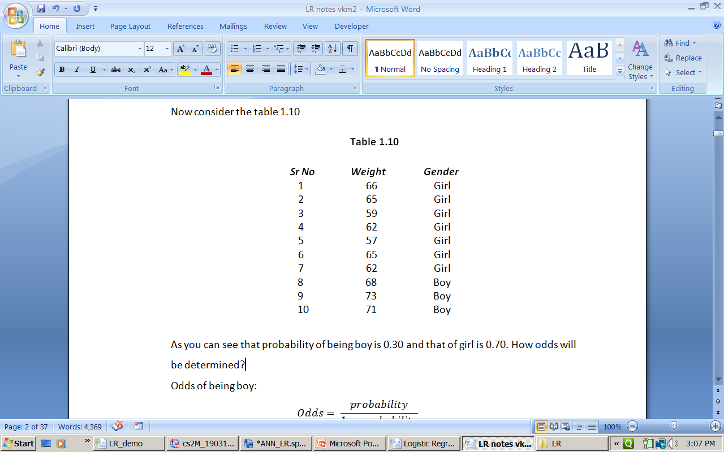
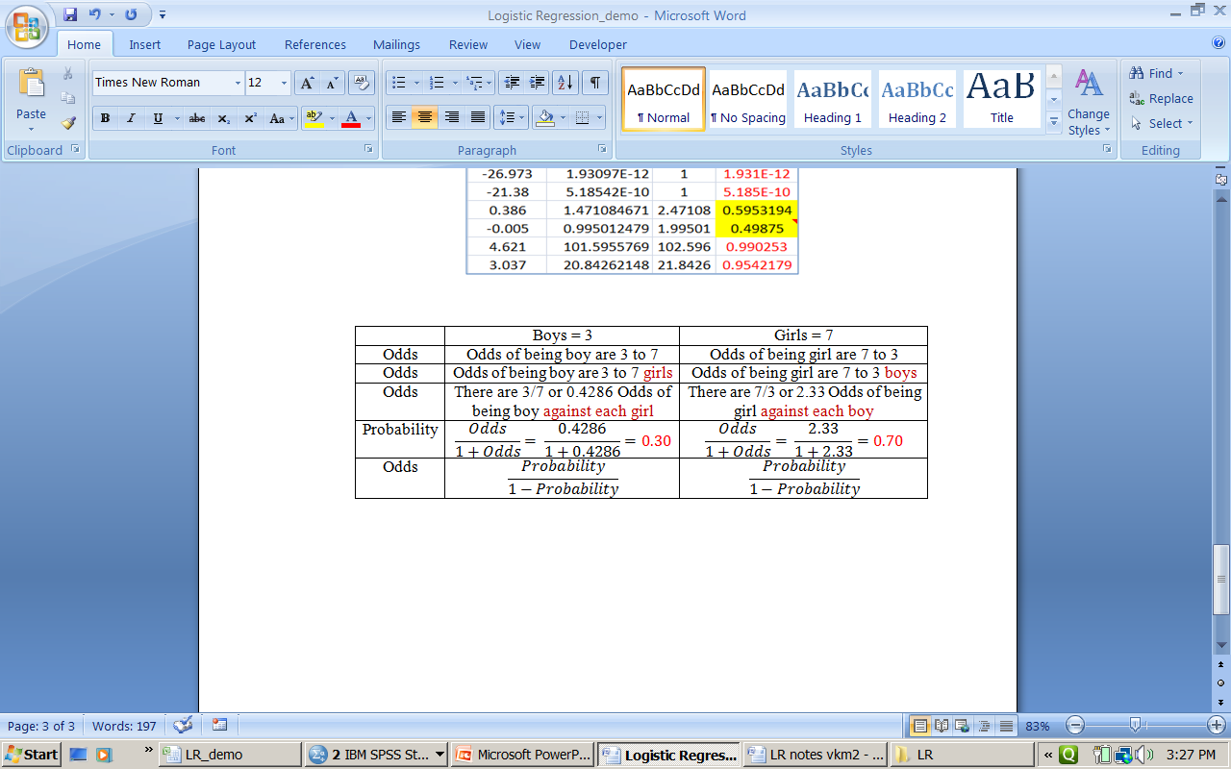
Odds versus Probability

Slide 4
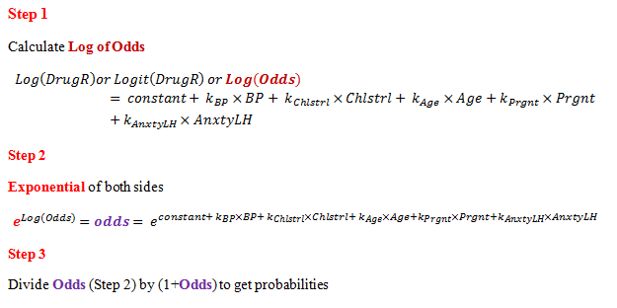
Logit Function and Probabilities

Slide 5
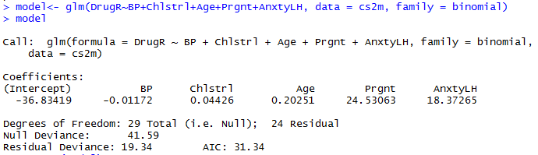
Import file: cs2m.csv Build Model

Slide 6
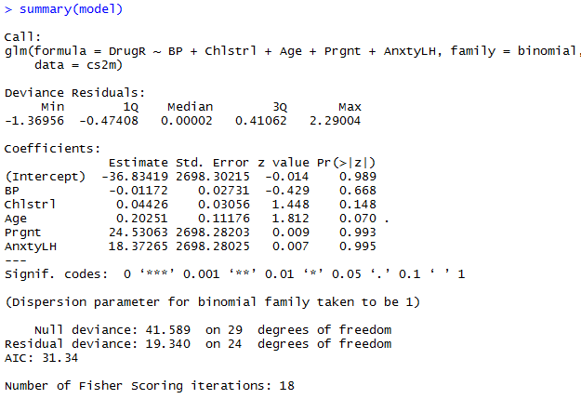
Summary

Slide 7
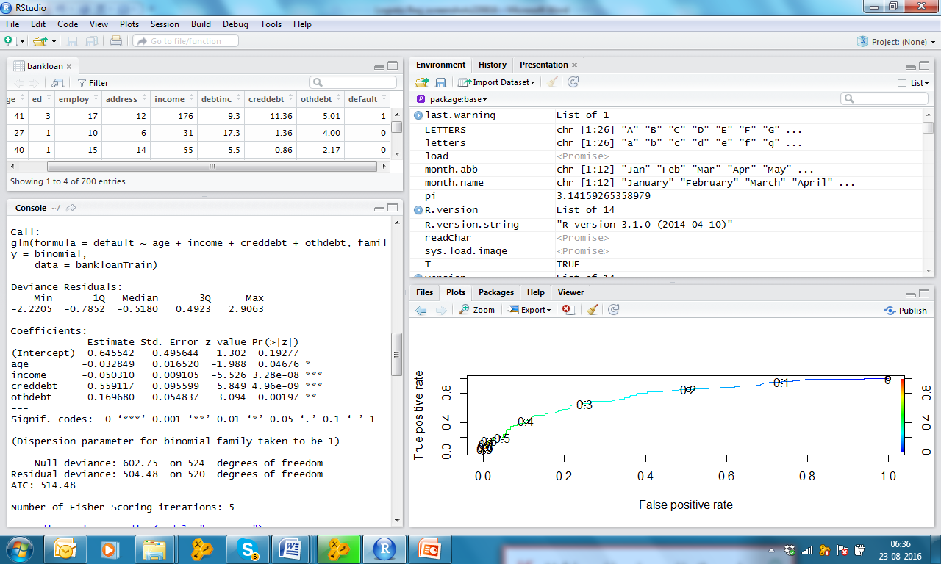
Model

Slide 8
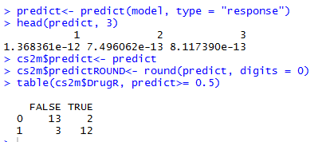
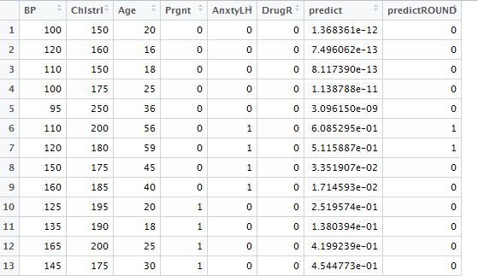
Classification Results

Slide 9
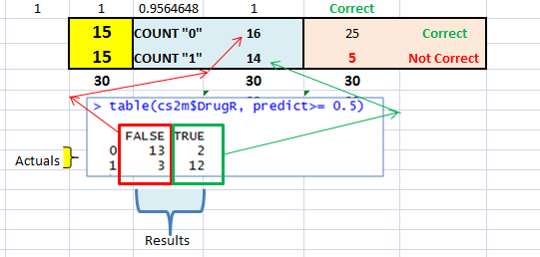

Slide 10
